Slide 1
Human Emotion Recognition
Project By - Dhruv Yadav
Course work - Digital Image Processing
Deep Learning
CNN (Convolutional Neural Networks)

Slide 2
References
https://openaccess.thecvf.com/content_cvpr_2017/html/Li_Reliable_Crowdsourcing_and_CVPR_2017_paper.html - theory was fantastic and helpful
https://www.kaggle.com/datasets/muhammadhananasghar/human-emotions-datasethes - for dataset
https://github.com/WuJie1010/Facial-Expression-Recognition.Pytorch - this link was really helpful for getting to know the structure and ideas of the code writing
https://chatgpt.com - for debugging and some prompts based codes.

Slide 3

—Dale Carnegie
“When dealing with people, remember you are not dealing with creatures of logic, but with creatures of emotion”.

Slide 4



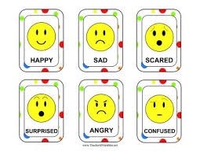

Problem Statement
Write a code which can recognize human emotions as happy, sad and angry.
I’ve used python for this purpose

Slide 5

Motivation
As the quote goes, it’s much evident that emotions are indistinguishable aspect of human existence.
Emotion recognition aims to automatically detect human emotions using various modalities like facial expressions, speech, or physiological signals.
It has applications in human-computer interaction, mental health monitoring, and affective computing.
Enhancing human-computer interaction by enabling machines to understand emotions.
Improving mental health diagnostics through automated emotion analysis and Enhancing recommendation systems and personalized content delivery based on user emotions.

Slide 6
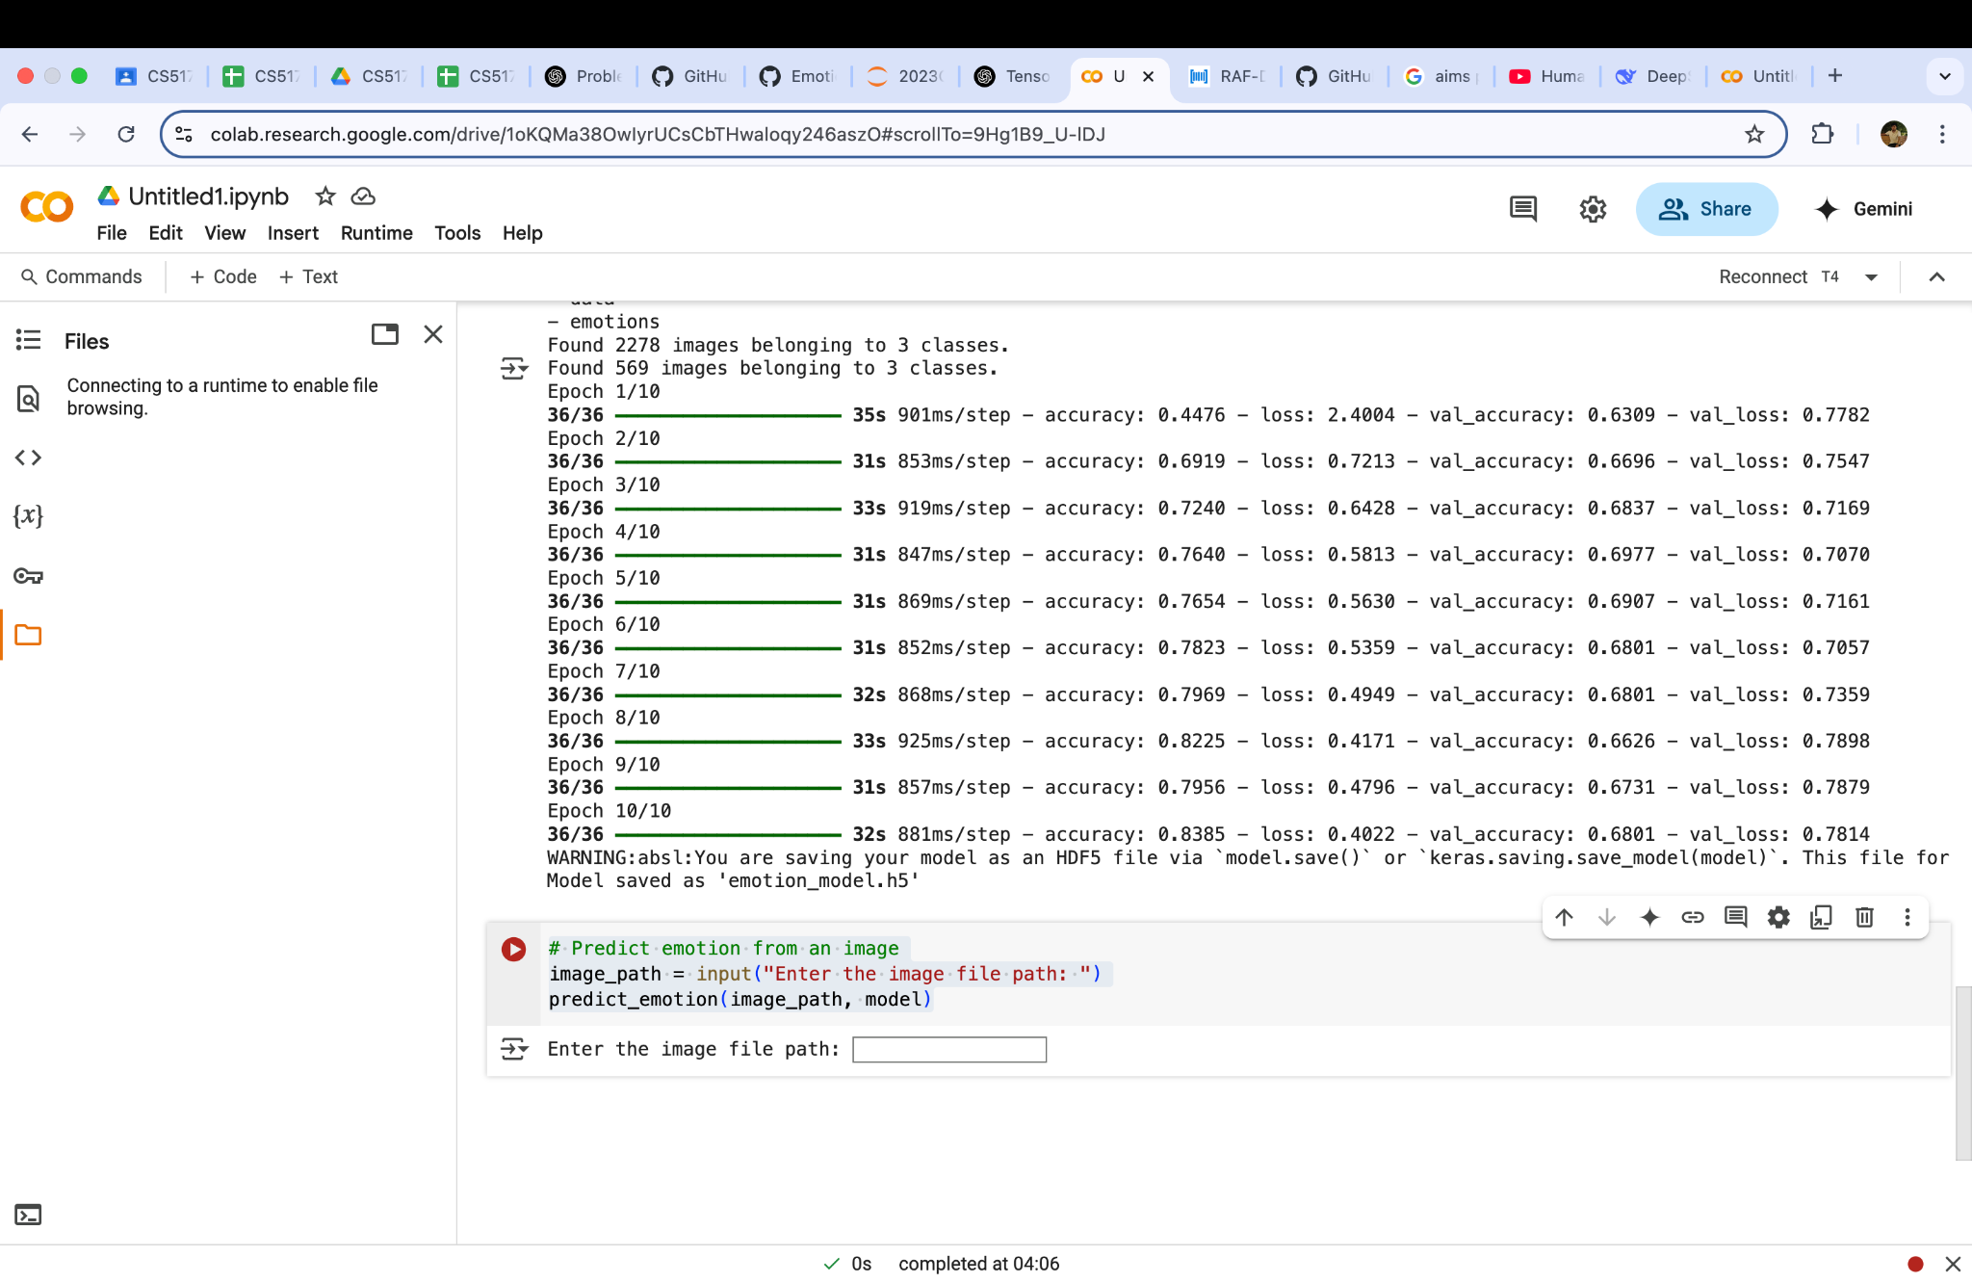
Input Format
My code takes an image as input, which is included in the folder or file path is properly described when asked. Following lines are responsible for getting the input
Explanation :
image_path is a string which is being taken as an input from the user. predict_emotion is a function which predicts the emotion based on the training given to the model using the dataset.

Slide 7
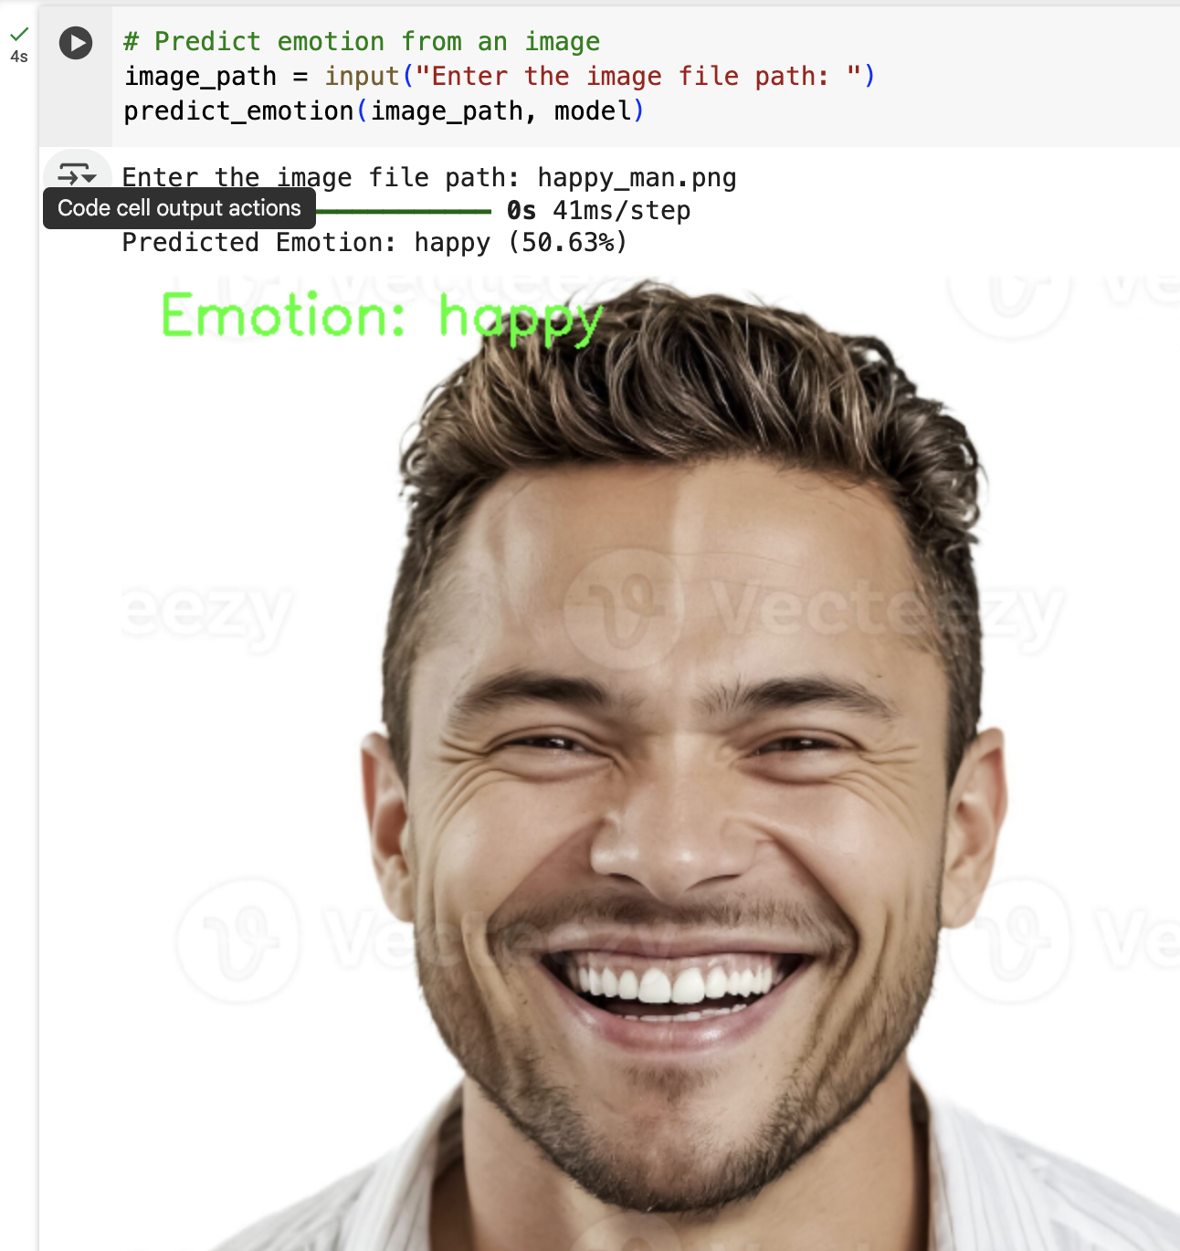
Output Format
My code while returning output, displays the image along with the emotion written. It also claims the emotion with a confidence (based on the training, it tells to what extent is the person angry, happy or sad. It may vary with normal human experience as its knowledge is based on the dataset which it is using.
I’ve also included dataset in the folder uploaded in the google form.

Slide 8
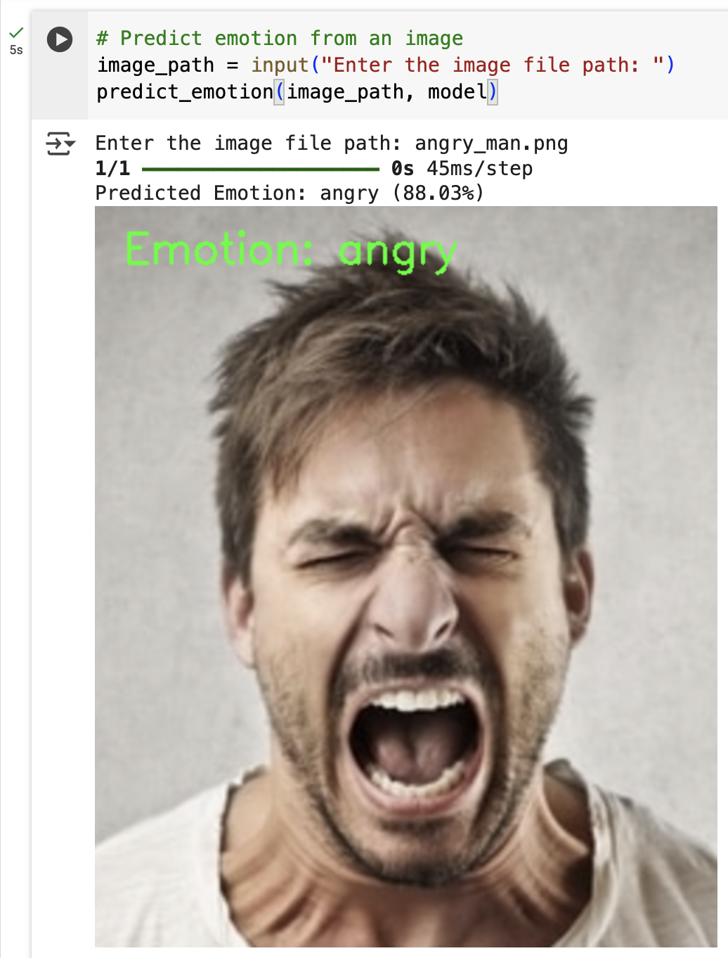
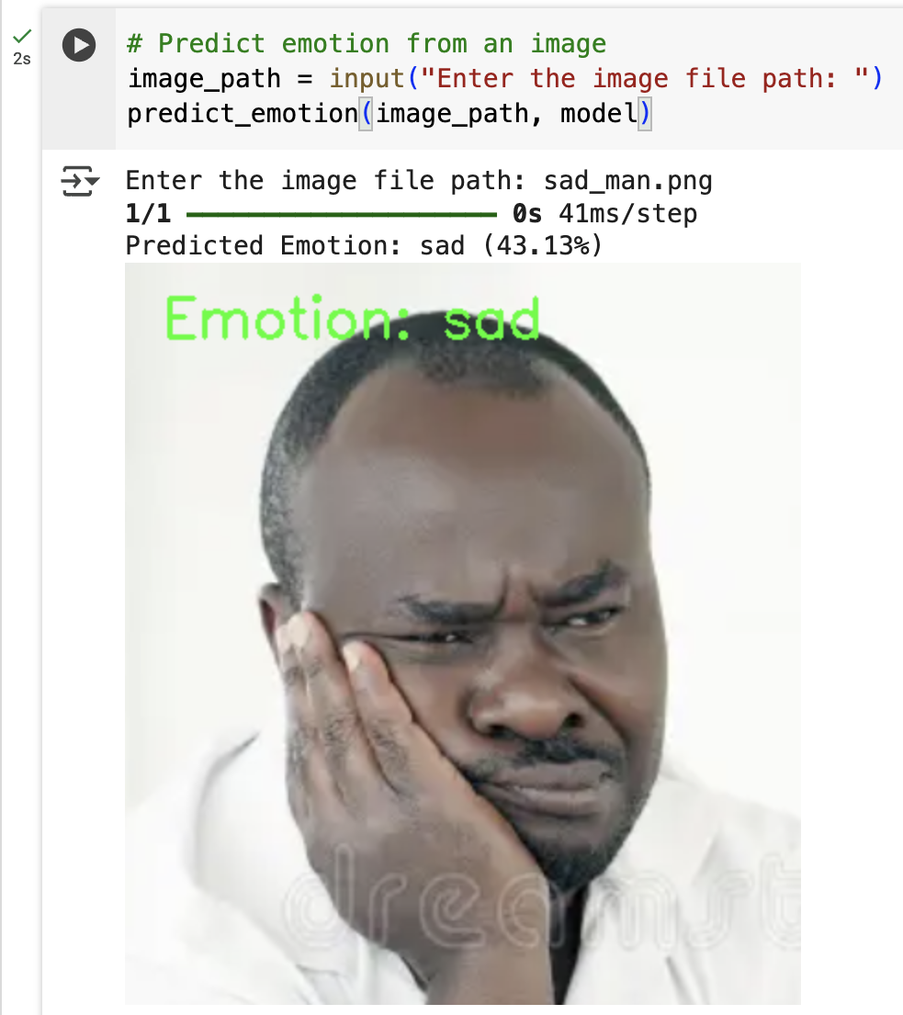
Output Format
_____ _____ _____ _____ _____ _____ _____ _____ _____ _____ _____ _____ _____ _____ _____ _____ _____
_____ _____ _____ _____ _____ _____ _____ _____ _____ _____ _____ _____ _____ _____ _____ _____ _____

Slide 9
1
Standard Data-sets in Human Emotion Recognition
My experience with Standard Data-sets was not at all good in Human Emotion Recognition. I couldn’t get non-erratic data set. Those which were without / with less errors were not in decent resolution (they were like 50 x 50 etc.) and those which were with errors gave indecent results. I had to used a data-set which was not with proper expressions (for training purpose). My results were bad due to that, it recognised my furious photo as sad. I then removed the erratic photos and retrained it with that data-set. But then data-set left was not of enough size. Finally I had to use the one which gave the best among all after experiments.

Slide 10
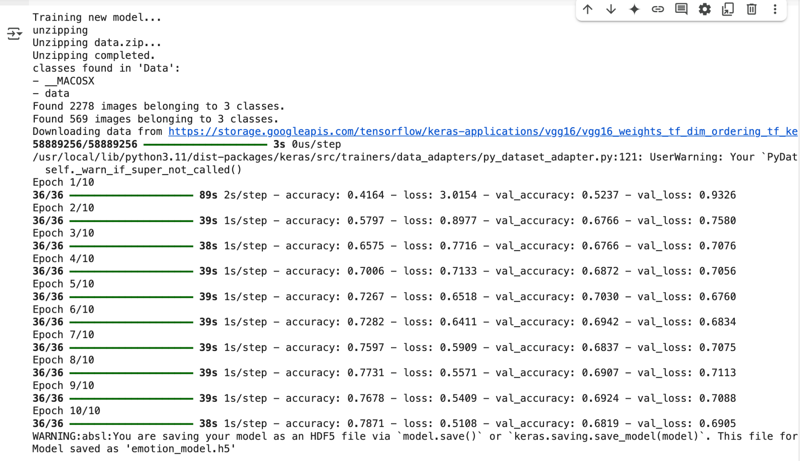
2
Evaluation Metrics - accuracy and loss
Here you can notice that there are four metrics in each Epoch:
accuracy
loss
val_accuracy
val_loss
Each of them are the metrics which define the compatibility of the model and the data-set for the purpose.

Slide 11
2
Evaluation Metrics - accuracy and loss
Metrics Used in Training :
Accuracy :
- Measures the proportion of correctly classified images.
- Formula :
- Intuition : Higher accuracy means better classification
Loss :
- Measures the difference between predicted and actual class probabilities.
- Formula :
- Intuition : Lower loss means better performance
__Total Predictions__
Correct Predictions​
Accuracy =
Loss = − ∑ y_{i} log(y_{i})

Slide 12
2
Evaluation Metrics - accuracy and loss
Validation Metrics (During testing) :
Validation Accuracy (val_accuracy) :
- Accuracy on unseen test data.
- Intuition : If train accuracy is high but val accuracy is low, the model is overfitting.
Validation Loss (val_loss) :
- Measures loss on validation data set.
- Intuition : If training loss decreases but val_loss increases, the model is overfitting.

Slide 13

3
Approach used in code
I have used Deep Learning Specifically the Architecture Named CNN
CNN stands for Convolutional Neural Networks
It is one of the most popular Architecture used for Image Processing and Pattern detection which works on mask / filter convolution.

Slide 14
Whoa!
How to do this Human Emotion Recognition !
Deep Learning :
Deep learning is a subset of machine learning that focuses on using artificial neural networks to process and learn from large amounts of data. It is inspired by the structure and function of the human brain and is particularly effective for tasks involving complex patterns, such as image recognition, natural language processing, and autonomous systems.

Slide 15

How does it work !
CNN (Convolutional Neural Networks) which is used for image processing. CNN is a popular architecture used in Deep Learning for image processing. We already know about convolution. CNN is related.
Like in convolution, CNN uses mask / filter to scan small regions of input image; extracts features such as edges, textures, and patterns. Each filter detects a different feature (e.g., vertical edges, horizontal edges, curves), and finally it uses dot product operations and slides over the image with strides (steps). In one algorithm, multiple CNN masks may be used for detection of different features.

Slide 16
3
Approach used in code - brief overview
Emotion Recognition using CNNs and Transfer Learning :
- Objective : Classify images into three emotions : Angry, Happy, Sad.
- Method : Use VGG16(Pretrained CNN) + Custom Layers
Data Preparation :
- Image Preprocessing :
- Resizing : not needed here (images already in 224 x 224)
- Normalization : scaling pixel values to [0, 1]
- Argumentation : Zoom, rotation to make model more robust (optional)
VGG16 is a pre-trained model trained on ImageNet (1M+ images).
We freeze its convolutional layers to retain feature extraction.
Custom layers : Flatten Layer, Dense Layer (128 neurons, ReLU activation), Dropout (0.1), Final Layer (3 neurons, Softmax activation) etc. are added

Slide 17
3
Approach used in code - brief overview
Custom Layers added :
- Flatten Layer : Converts feature maps into a 1D array
- Dense Layer : (128 neurons, ReLU activation) : Learn patterns
- Dropout (0.1) : Prevents overfitting
- Final Layer : (3 neurons, Softmax activation) : Outputs class probabilities
Prediction Pipeline : Making predictions on new images
- Load image & resize to 224 x 224
- Convert to array and normalize
- Predict Class using Softmax Output
- Display Image with Predicted Emotion

Slide 18
4
Results obtained by testing my code and comparison with paper
I noticed that the results that I had obtained were not always correct. However, for the images in which the emotions were clearly visible were identified correctly. Other than that, it sometimes recongnized the frowning which is observed while crying as an act of anger and similarly some other weird results were observed. In some clear expressions the recognition percentage were less. However, emotions were identified. I have attached some images that showed these kind of results, in the next slide.

Slide 19
4
Results obtained by testing my code and comparison with paper

Slide 20
6
My Learning from this project
I learnt about some fascinating concepts of Deep Learning and Machine Learning.
Especially about CNN (Convolutional Neural Networks).
In context of this project, I tried a few things :-
Training with small datasets (undersampling).
Training extensively so that model starts to cram (overfitting).
What happens when one of emotions is overfed (it’s almost always returned)
Other than that, I tried different data sets and realized that feeding correct data is more important that the quality of model you use. I also tried using the models such as ResNet. However, I rejected those because VGG16 was giving best results for me.

